Slide 1
PROJECT TITLE
CAPSTONE PROJECT
Presented By:
Student Name-Abhipsa Rout
College Name-KIIIT University
Department-MCA

Slide 2
OUTLINE
Problem Statement (Should not include solution)
System Development Approach (Technology Used)
Algorithm & Deployment (Step by Step Procedure)
Result
Conclusion
Future Scope(Optonal)
References

Slide 3
Problem Statement
In today’s data-driven environment, organizations are increasingly relying on predictive analytics to make informed decisions about workforce planning, compensation structuring, and talent management. The central objective of this project is to develop a predictive model capable of determining whether an individual earns more than $50,000 per year based on a variety of personal and professional attributes. This involves analyzing a structured dataset that includes demographic details (such as age, gender, and marital status), educational background, employment information, working hours, and financial indicators like capital gains and losses.
The dataset used originates from the UCI Machine Learning Repository and represents a real-world challenge often faced by HR departments and data scientists: how to predict income categories with high accuracy using limited and diverse inputs. Framing this as a binary classification problem allows us to explore various machine learning algorithms to identify the most effective model for predicting income groups.
The motive behind this project is multifaceted. From an HR perspective, such predictive models can support decision-making in salary standardization, identifying high-potential candidates, and forecasting compensation trends. From a data science standpoint, it offers an opportunity to apply practical machine learning skills, such as data preprocessing, feature selection, model comparison, and performance evaluation. Furthermore, the insights derived from the analysis can help organizations optimize recruitment strategies, improve equity in pay scales, and align compensation with performance and market standards.
This project not only aims to build a robust classifier but also serves as a demonstration of how machine learning can be leveraged to extract meaningful intelligence from human resource data. Ultimately, it highlights the practical application of artificial intelligence in solving real-world business problems related to income prediction and employee profiling.

Slide 4
System Approach
1. System Requirements
To ensure smooth execution of the project, the following system specifications are recommended:
Operating System: Windows 10 or above / Linux / macOS
Processor: Intel Core i5 or higher
RAM: Minimum 8 GB (Recommended 16 GB for faster computation)
Storage: At least 500 MB of free space for data and dependencies
Software Requirements:
Python 3.7 or above
Jupyter Notebook / VS Code
Web browser (for visualization, deployment testing)

Slide 5
SYSTEM APPROACH
pandas, numpy
numpy supports numerical operations, especially with arrays and pandas is used for handling structured data (like CSV files) and performing operations such as filtering, grouping, and transforming datasets.
matrices, and serves as the backbone for numerical computations in machine learning.
matplotlib, seaborn
These libraries are used for data visualization.
matplotlib provides basic plotting tools (line, bar, boxplots), while seaborn builds on it to offer more attractive and statistical visualizations like correlation heatmaps or distribution plots.
scikit-learn
A powerful and widely-used machine learning library.
It includes tools for classification, regression, model selection, preprocessing (e.g., scaling, encoding), and evaluation metrics like accuracy, confusion matrix, and classification reports.

Slide 6
System Approach
xgboost
An optimized gradient boosting library designed for speed and performance.
It is commonly used in structured/tabular data problems and often gives higher accuracy in classification tasks.
joblib
Used to save (serialize) and load (deserialize) trained machine learning models.
This is especially useful for deployment, so the model doesn't need to be retrained every time.
streamlit (optional)
A Python library for creating web applications for machine learning and data science projects.
Helps build an interactive UI where users can input data and see predictions in real time.
pip
Python’s package manager used to install and manage libraries like the ones listed above.
Essential for setting up and maintaining the project environment.

Slide 7
Algorithm & Deployment
1. Data Collection
The project begins with gathering data. The Adult Income Dataset from the UCI Machine Learning Repository was selected because it is a standard dataset for income prediction tasks. It contains over 48,000 records with attributes like:
Age, Education, Occupation, Workclass, Race
Marital Status, Relationship, Capital Gain/Loss, Hours per week
Final target label: Income (<=50K or >50K)
This dataset is ideal for classification problems and represents real-world data from the US Census.

Slide 8
Algorithm & Deployment
2. Data Preprocessing
Raw data must be cleaned and prepared before model training. This step includes:
Handling Missing Values:
Missing entries (represented as ?) in columns like workclass, occupation, and native-country were replaced with a common category like "others" to maintain data integrity.
Removing Irrelevant/Rare Categories:
Categories that had very few samples such as “Never-worked” or “Preschool” in education or occupation were removed as they introduce noise and are not statistically significant.
Outlier Detection:
Outliers in numeric columns like age, capital-gain, and hours-per-week were identified using boxplots and removed to avoid skewing the model.
Categorical Encoding:
All non-numeric features were transformed using LabelEncoder, which converts categorical values to integers for compatibility with ML models.
Feature Scaling:
Algorithms like KNN and SVM are sensitive to data scale, so MinMaxScaler or StandardScaler was used to normalize/standardize features to a similar range.

Slide 9
Algorithm & Deployment
3. Train-Test Split
To evaluate model performance, the dataset was divided using train_test_split:
80% for training, to teach the model patterns in the data.
20% for testing, to evaluate how well the model generalizes to new, unseen data.
Stratification was used to ensure the income class distribution (<=50K, >50K) was balanced across both training and testing datasets.
4. Model Training
Multiple classification algorithms were trained to find the most accurate one. These included:
Linear Models: Logistic Regression
Distance-Based: K-Nearest Neighbors (KNN)
Tree-Based: Random Forest, Extra Trees, Decision Tree
Boosting Models: Gradient Boosting, AdaBoost
Other Algorithms: SVM, Naive Bayes, Bagging
Each model was implemented using a Pipeline, which combines preprocessing (e.g., scaling) and training, ensuring consistent data flow and reproducibility.

Slide 10
Algorithm & Deployment
5. Model Evaluation
Each model was evaluated using multiple metrics:
Accuracy Score: Basic metric showing overall correctness.
Classification Report: Shows precision, recall, and F1-score for each class, giving a more detailed insight into performance, especially with imbalanced classes.
Confusion Matrix: Visual matrix showing true vs predicted values, helpful in identifying misclassifications.
A bar chart was generated to compare model accuracies visually.
6. Ensemble Learning
To improve prediction performance:
A VotingClassifier was built using Gradient Boosting, AdaBoost, and Random Forest as base learners.
Soft voting was used, which takes the average predicted probabilities from each model to make the final prediction.
Ensemble models are often more robust than single classifiers.

Slide 11
Algorithm & Deployment
.
7. Model Selection & Saving
After evaluation, the model with the highest accuracy and best metrics was chosen as the final model.
This model was saved using joblib.dump() into a .pkl file.
This allows the trained model to be reused without retraining, saving time and resources.
8. Deployment
To make the model accessible to end-users:
The model can be deployed using Streamlit, a lightweight Python framework for building web apps.
Users can interact via a graphical interface where they enter input data (like age, education, occupation, etc.).
The app loads the trained .pkl model, process user input, and predicts whether their income is <=50K or >50K.
This makes the model practical and useful for real-time predictions

Slide 12
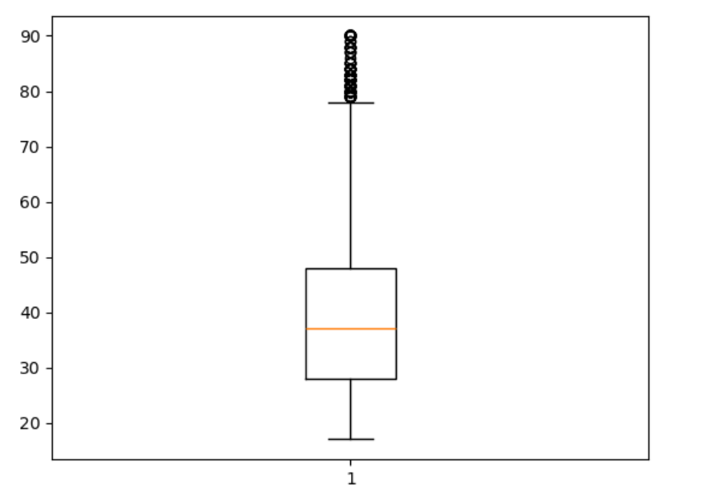
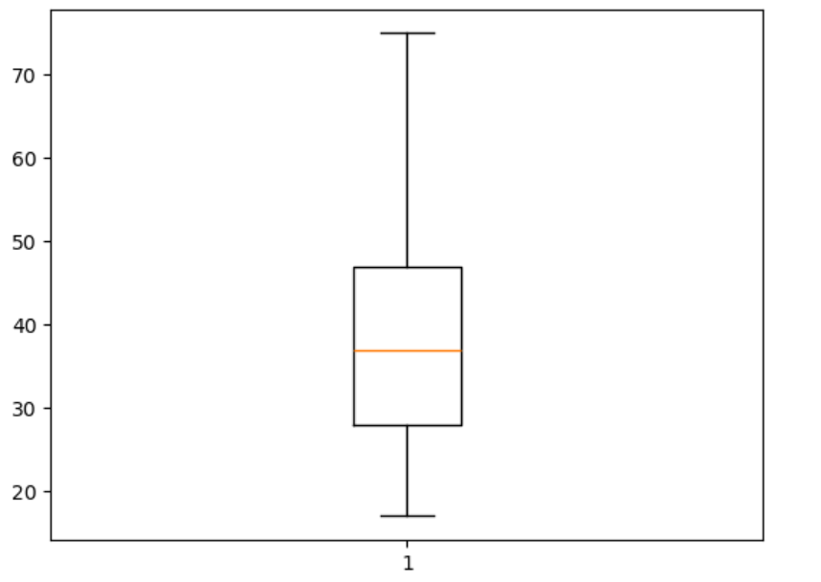
Result
Figure 1.0
Figure 1.1
Figure 1.0 shows boxplot of ‘age’ with outliers.
Figure 1.0 shows boxplot of ‘age’ after removing outliers.

Slide 13
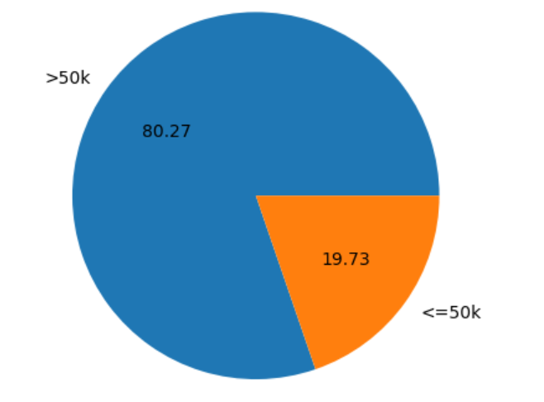
Result
Figure 1.3
Figure 1.3 shows piechart of gender

Slide 14
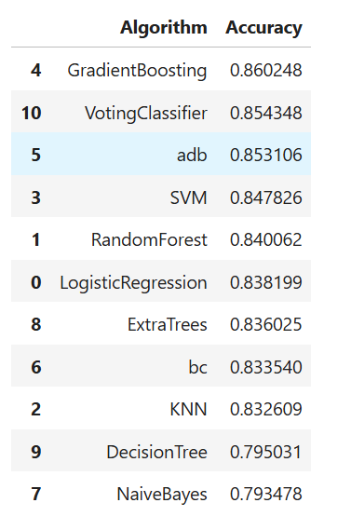
Result
Figure 1.4
Figure 1.4 shows the algorithm in the ascending order of Accuracy.

Slide 15
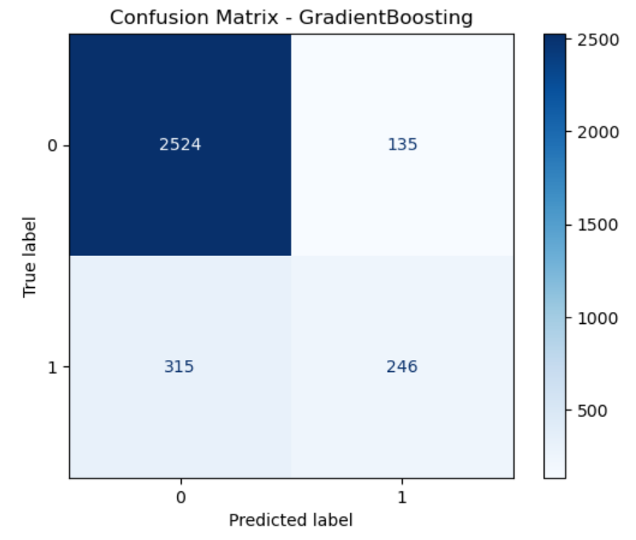

Result
Figure 1.5
Figure 1.6
Figure 1.5 shows the Best model as GradientBoosting .
Figure 1.6 shows the Confusion Matrix of GradientBoosting .

Slide 16
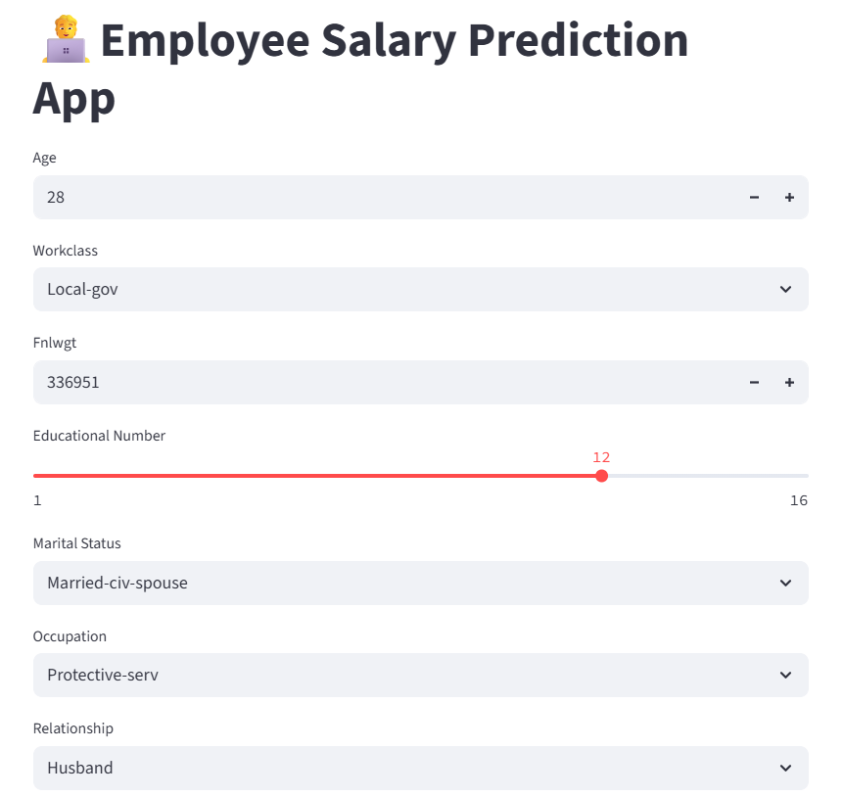
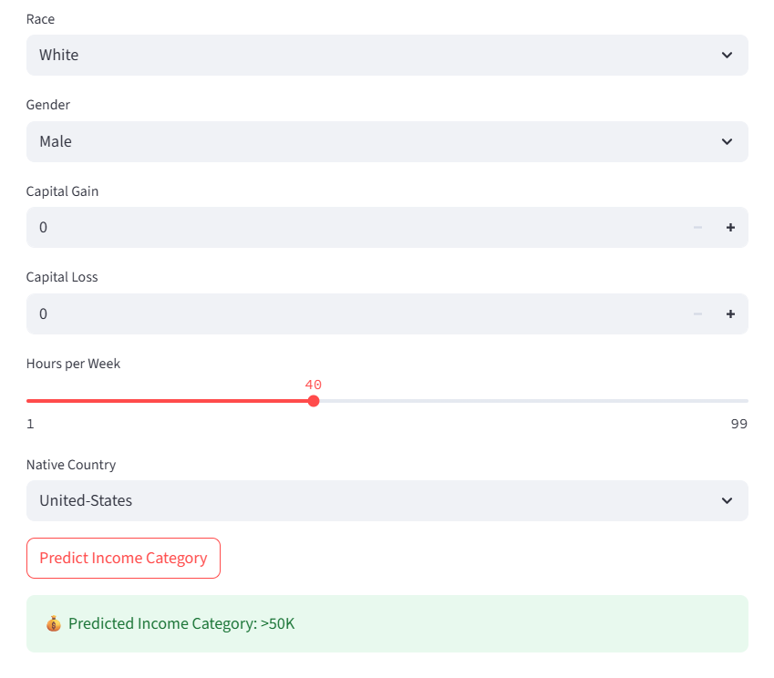
Result
This Figure shows the output result page and result of the Employee Salary Prediction App

Slide 17
Result
Attach your Github link
https://github.com/AbhipsaRout/Employee_Salary_Prediction.git

Slide 18
Conclusion
This project successfully demonstrated the use of supervised machine learning algorithms to predict whether an individual earns more than $50,000 per year based on demographic and employment attributes. Through rigorous data preprocessing, model evaluation, and comparison of various classifiers, we identified Gradient Boosting and ensemble methods like Voting Classifier as top performers with high predictive accuracy.
The models provide valuable insights that can aid in HR analytics, helping organizations make data-driven decisions in recruitment, compensation planning, and workforce management. Deployment via Streamlit makes the solution accessible for real-time predictions through a user-friendly interface.
During implementation, some challenges were encountered such as handling missing values, addressing imbalanced classes, and optimizing model performance. Additionally, tuning hyperparameters for ensemble methods required computational resources and careful experimentation.
Future improvements may include using deep learning models, expanding the dataset, or integrating more advanced feature engineering techniques. Incorporating explainable AI methods could also help interpret model decisions, making the system more transparent and actionable for stakeholders.

Slide 19
Future scope(Optional)
The income prediction system based on the Adult dataset has promising potential for future development. As data becomes increasingly central to workforce analytics, enhancing this model could serve multiple strategic functions in HR and organizational planning. One immediate scope is integrating more diverse datasets that include updated income brackets, job roles, and regional economic factors to improve generalizability. Currently, the model is trained on a dated dataset; hence, updating it with real-time or geographically diverse data can enhance its accuracy and relevance.
Moreover, deep learning models such as neural networks can be explored to capture complex nonlinear relationships among features that traditional machine learning models might overlook. These advanced models could significantly boost prediction power when trained on larger datasets.
From an application perspective, the model can be embedded into HR management systems as a decision support tool. It can assist in tasks like salary benchmarking, hiring prioritization, and workforce segmentation. Additionally, building a more interactive, user-friendly deployment interface using tools like Streamlit, Flask, or Dash can make the tool accessible to non-technical HR professionals.
Another expansion could include explainability tools such as SHAP or LIME to help users understand why a particular prediction was made. This is crucial in real-world use cases where transparency is essential for trust and compliance.

Slide 20
Future scope(Optional)
Furthermore, incorporating additional features such as job satisfaction, company size, industry, or geographic region could make the predictions more contextual and robust. Regular retraining of the model with fresh data will ensure the system adapts to evolving economic and labor market trends.
In the long run, this model could be scaled and integrated into enterprise-level analytics platforms or cloud-based HR solutions, transforming it into a comprehensive income and talent analytics engine.

Slide 21
References
UCI Machine Learning Repository Adult Data Set – The dataset used for training and testing was sourced from: https://archive.ics.uci.edu/ml/datasets/adult This dataset contains demographic and income-related attributes used to predict whether a person earns over $50K.
Scikit-learn Documentation Machine Learning Tools & Algorithms – Official documentation of Scikit-learn was instrumental in implementing models such as Logistic Regression, Random Forest, SVM, and ensemble methods. https://scikit-learn.org/stable/documentation.html
Pandas & NumPy Data Preprocessing & Numerical Computation – Used for cleaning, transforming, and managing structured data.
Pandas: https://pandas.pydata.org/
NumPy: https://numpy.org/

Slide 22
References
Streamlit Documentation Model Deployment & Web App – Used to create an interactive front end for users to input features and view predictions. https://docs.streamlit.io/
Joblib Documentation Model Serialization – Used to save and load the trained machine learning models. https://joblib.readthedocs.io/
Ensemble Learning Research Voting Classifier & Model Stacking – Concepts for combining multiple classifiers to improve accuracy were referenced from ensemble learning literature.
Zhou, Zhi-Hua. Ensemble Methods: Foundations and Algorithms. CRC Press, 2012.
Dietterich, T.G. "Ensemble Methods in Machine Learning." International Workshop on Multiple Classifier Systems, 2000.
Visualization Libraries Matplotlib & Seaborn – Used to visualize accuracy comparison and confusion matrices.
Matplotlib: https://matplotlib.org/
Seaborn: https://seaborn.pydata.org/

Slide 23
THANK YOU

